Slide 1

Decentralized Collective Construction
Physical model of a vertical Tower
http://www.csiberkeley.com/files/images/SAP15_770.jpg

Slide 2
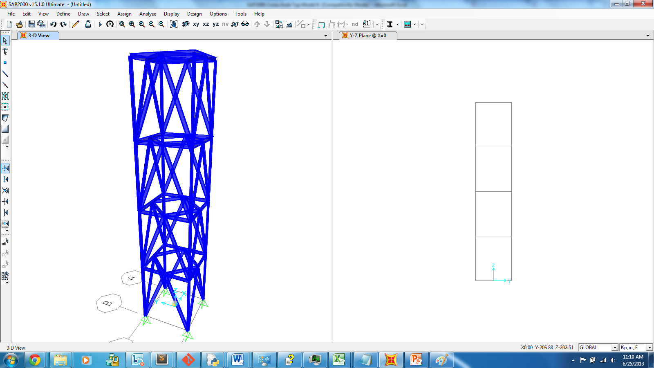
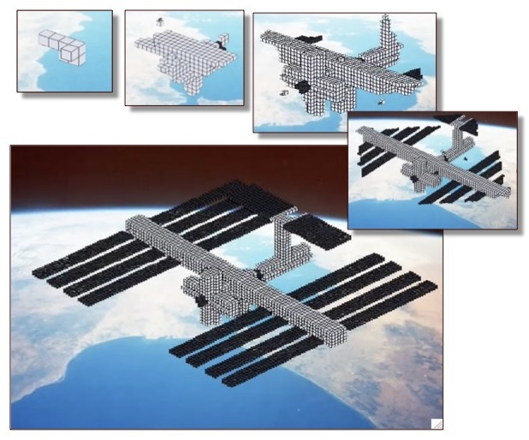
Expectations.
Debugged Simulations Suite
Stable Tower Model
Simple Rule Set (Algorithm)
Adaptive Behaviors
Wind
Heat
Structural Decay
Extreme Environments
http://www.eecs.harvard.edu/ssr/projects/cons/c3.jpg

Slide 3
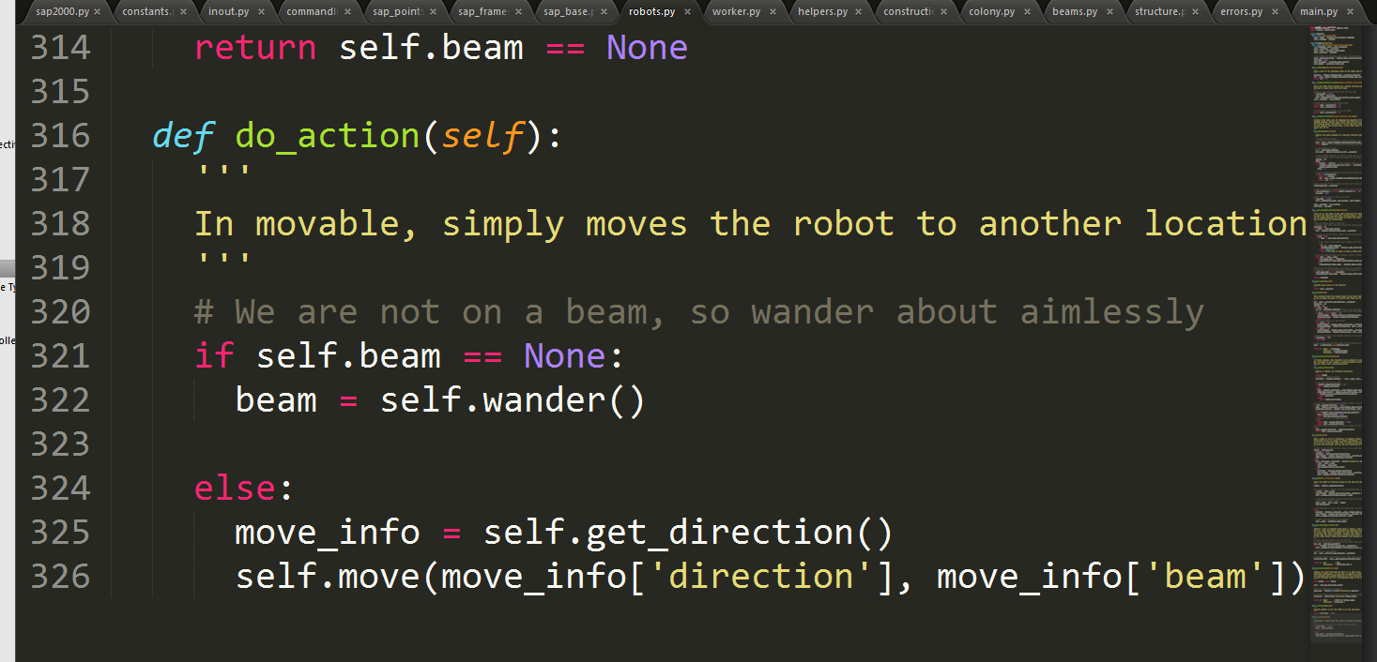
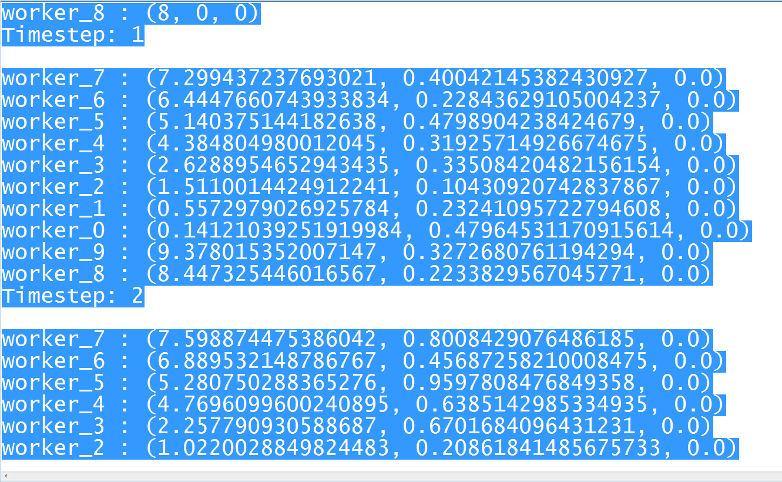
So Far: Simulation and Robot Swarm
Structural Analysis Program
SAP 2000 OAPI
Python Interface
Mobile Swarm
Random Rules

Slide 4
Research Steps: Vertical Tower Simulation
Explore
Set Rules
Run Simulation
Analyze
Failed Model
Modify
How, why?
Previous Model Results
Possible new rules?

